Slide 1
几何变换与投影
Math.
OpenGL
Programming

Slide 2

相机
3D is just like taking a photograph!
viewing
volume
camera
model
tripod

Slide 3
Camera Analogy and Transformations
投影变换
  相机的镜头
视点变换
  三脚架的位置和方向
模型变换
  移动模型
视口变换
  照片大小

Slide 4
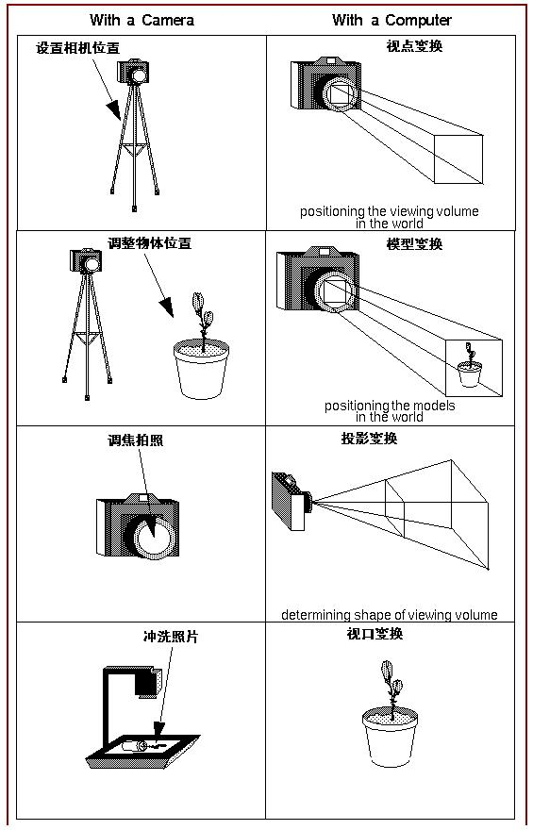

Slide 5
坐标系统与变换
Steps in Forming an Image
  specify geometry (world coordinates)
  specify camera (camera coordinates)
  project (window coordinates)
  map to viewport (screen coordinates)
Each step uses transformations
Every transformation is equivalent to a change in coordinate systems

Slide 6
仿射变换Affine Transformations
Want transformations which preserve geometry
  lines, polygons, quadrics
Affine = line preserving
  Rotation, translation, scaling
  Projection
  Concatenation (composition)

Slide 7
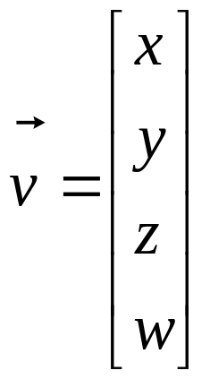
齐次坐标Homogeneous Coordinates
  each vertex is a column vector
  w is usually 1.0
  all operations are matrix multiplications
  directions (directed line segments) can be represented with w = 0.0

Slide 8

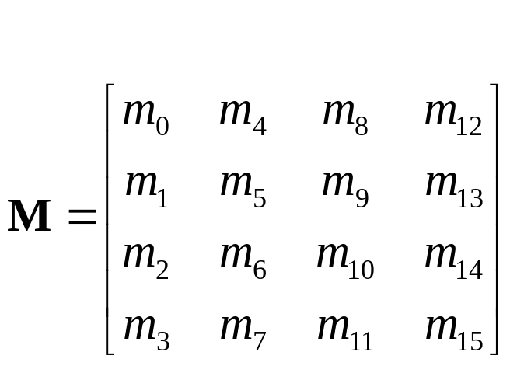
Homogeneous Coordinates
A vertex is transformed by 4 x 4 matrices
  all affine operations are matrix multiplications
  all matrices are stored column-major in OpenGL
  matrices are always post-multiplied
  product of matrix and vector is

Slide 9
Compositing Modeling Transformations
Combine transformations
v’=NMLv=N(M(L(v)))
Transform(N);
Transform(M);
Transform(L);
Draw_Point(v);

Slide 10
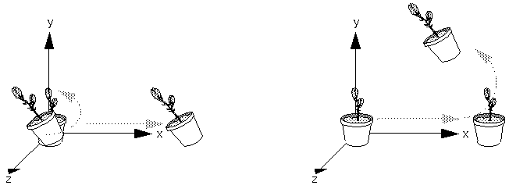
Thinking about Transformations
Figure : Rotating First or Translating First
glMultMatrixf(T); /* apply translation T */ glMultMatrixf(R); /* apply Rotation R */ Draw_Objects(v); /* draw transformed vertex v */

Slide 11
Transformation Pipeline in OpenGL
object
eye
clip
normalized
device
window
v
e
r
t
e
x
Modelview
Matrix
Projection
Matrix
Perspective
Division
Viewport
Transform
Modelview
Projection
Modelview
●
●
●

Slide 12
Specifying Transformations
Programmer has two styles of specifying transformations
  specify matrices (glLoadMatrix, glMultMatrix)
  specify operation (glRotate, glOrtho)
  Programmer does not have to remember the exact matrices

Slide 13
Matrix Operations
Specify Current Matrix
  glMatrixMode( GL_MODELVIEW or GL_PROJECTION )
Other Matrix
  glLoadIdentity()

Slide 14
Modeling Transformations
Move object
  glTranslate{fd}( x, y, z )
Rotate object around arbitrary axis
  glRotate{fd}( angle, x, y, z )
  angle is in degrees
Dilate (stretch or shrink) or mirror object
  glScale{fd}( x, y, z )
  [ glMultMatrix(); ]
  See Demo.

Slide 15
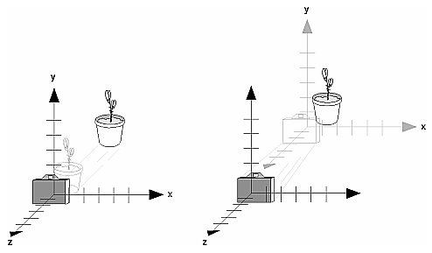
Viewing Transformations
glTranslate(); glRotate();
  e.g. glTraslatef(0.0,0.0,-5.0);

Slide 16
Viewing Transformations
Position the camera/eye in the scene
  place the tripod down; aim camera
To “fly through” a scene
  change viewing transformation and
  redraw scene
gluLookAt( eye_{x}, eye_{y}, eye_{z},
aim_{x}, aim_{y}, aim_{z},
up_{x}, up_{y}, up_{z} )
  up vector determines unique orientation

Slide 17
Connection: Viewing and Modeling
Moving camera is equivalent to moving every object in the world towards a stationary camera
Viewing transformations are equivalent to several modeling transformations

Slide 18
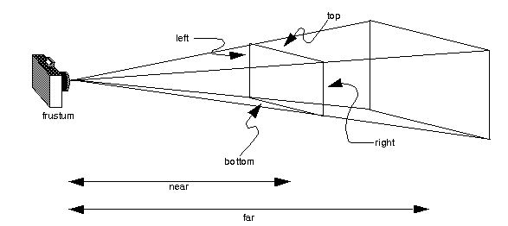
Projection Transformation
Shape of viewing frustum
Perspective projection
  glFrustum( left, right, bottom, top, zNear, zFar )
  (left,bottom,-near), (ringht,top,-near)

Slide 19
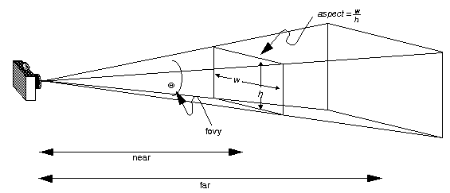
Projection Transformation
Shape of viewing frustum
Perspective projection
  gluPerspective( fovy, aspect, zNear, zFar )

Slide 20
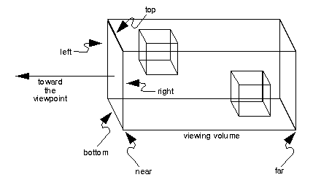
Projection Transformation
Orthographic parallel projection
  glOrtho( left, right, bottom, top, zNear, zFar )
  gluOrtho2D( left, right, bottom, top )
    calls glOrtho with z values near zero

Slide 21
使用投影变换
Typical use (orthographic projection)
  glMatrixMode( GL_PROJECTION );
  glLoadIdentity();
  glOrtho( left, right, bottom, top, zNear, zFar );
  See Demo.

Slide 22
Common Transformation Usage
Usually called when window resized
Registered as callback for glutReshapeFunc(resize)

Slide 23
resize(): Perspective & LookAt
void resize( int w, int h )
{
glViewport( 0, 0, (GLsizei) w, (GLsizei) h );
glMatrixMode( GL_PROJECTION );
glLoadIdentity();
gluPerspective( 65.0, (GLfloat) w / h,
1.0, 100.0 );
glMatrixMode( GL_MODELVIEW );
glLoadIdentity();
gluLookAt( 0.0, 0.0, 5.0,
0.0, 0.0, 0.0,
0.0, 1.0, 0.0 );
}

Slide 24
resize(): Perspective & Translate
Same effect as previous LookAt()
void resize( int w, int h )
{
glViewport( 0, 0, (GLsizei) w, (GLsizei) h );
glMatrixMode( GL_PROJECTION );
glLoadIdentity();
gluPerspective( 65.0, (GLfloat) w/h,
1.0, 100.0 );
glMatrixMode( GL_MODELVIEW );
glLoadIdentity();
glTranslatef( 0.0, 0.0, -5.0 );
}

Slide 25
Viewport Transformation
  glViewport( x, y, width, height )
  (x, y) specifies the lower left corner of the viewport,
  (width , height) are the size of the viewport rectangle.
    usually same as window size
    viewport aspect ratio should be same as projection transformation or resulting image may be distorted

Slide 26
Matrix Stacks
glPushMatrix();
  copies the current matrix and adds the copy to the top of the stack
glPopMatrix();
  discards the top matrix on the stack
glPushMatrix() means "remember where you are" and glPopMatrix() means "go back to where you were."

Slide 27
Modelview & Projection Matrix Stack
glMatrixMode(GL_MODELVIEW);
  for constructing hierarchical models
glMatrixMode(GL_PROJECTION);
  No compose projection
  only two levels deep
  e.g. For displaying text
glMatrixMode(GL_PROJECTION); glPushMatrix(); /*save the current projection*/
glLoadIdentity();
glOrtho(...); /*set up for displaying help*/
display_the_help();
glPopMatrix();

